Slide 1


Insurance Fraud Analysis
Team:
Asif Hassan
waheed ahmad
gangadhar reddy
imam Farooq
Lokesh dange
Sajad shafi

Slide 2
Introduction
Insurance fraud detection is a challenging problem, given the variety of fraud patterns and relatively small ratio of known frauds in typical samples.
Insurance frauds cover the range of improper activities which an individual may commit in order to achieve a favorable outcome from the insurance company.
According to FBI, the insurance industry in the USA consists of over 7000 companies that collectively received over $1 trillion annually in premiums. FBI also estimates the total cost of insurance fraud (non-health insurance) to be more than $40 billion annually.
It must be noted that insurance fraud is not a victimless crime – the losses due to frauds, impact all the involved parties through increased premium costs, trust deficit during the claims process and impacts to process efficiency and innovation.
Hence the insurance industry has an urgent need to develop capability that can help identify potential frauds with a high degree of accuracy, so that other claims can be cleared rapidly while identified cases can be scrutinized in detail.
Team: Data Pirates

Slide 3
Potential Situations could include:-
Covering-up for a situation that wasn’t covered under insurance (e.g. drunk driving, performing risky acts, illegal activities etc.).
Misrepresenting the context of the incident: This could include transferring the blame to incidents where the insured party is to blame, failure to take agreed upon safety measures.
Inflating the impact of the incident: Increasing the estimate of loss incurred either through addition of unrelated losses (faking losses) or attributing increased cost to the losses.
Team: Data Pirates

Slide 4
Why Machine Learning in Fraud Detection?
The traditional approach for fraud detection is based on developing heuristics around fraud indicators.
Based on these heuristics, a decision on fraud would be made in one of two ways.
In certain scenarios rules would be framed that would define if the case needs to be sent for investigation.
In other cases, a checklist would be prepared with scores for the various indicators of fraud. An aggregation of these scores along with the value of the claim would determine if the case needs to be sent for investigation. The criteria for determining indicators and the thresholds will be tested statistically.
Team: Data Pirates

Slide 5
The challenge with the above approaches:-
They rely very heavily on manual intervention which will lead to the following limitations:
More human resources needed.
Constrained to operate with a limited set of known parameters based on heuristic knowledge – while being aware that some of the other attributes could also influence decisions.
Incidence of fraud (as a percentage of the overall claims) is low typically less than 1% of the claims are classified. Additionally new techniques for fraud needs to be uncovered on a proactive basis.
Team: Data Pirates

Slide 6
AIM?
Design a model that will predict weather an insurance claim is fraud or genuine.
Team: Data Pirates

Slide 7
Steps:-
Business and Data understanding
Exploratory Data Analysis (EDA)
Deployment
Visualization
Evaluation
Model Building
Team: Data Pirates

Slide 8

Data Understanding

Slide 9
Feature Engineering:-
Features to be selected:
Areas of service: Areas of service will be taken into count as the urban people are not that aware as the rural people so in rural areas (cities) chances of fraud are higher then urban(village) areas.
Hospital Id: Based on the claim, insurance company will visit the hospital to check weather the person was sick or not.
Age: People with less age get cheaper plans as there is low risk of mortality. If a person with less age claims a higher amount we can classify it under fraud claim.
Gender: The reason for this is that gender differences in medical conditions are likely to affect how often the policy holder will bill the insurance policy. For this reason health insurance plans tend to hike up premium cost for women of childbearing age as compared to that of men.
No of days spend in hospital: The more time spend by a patient in the hospital will cost a high amount so the patient will claim high amount from the insurance company. But if hospital provides wrong information about the patient time spend in hospital will lead to fraud claim.
Team: Data Pirates

Slide 10
Admission type: A patient admitted under one type can claim as he was admitted under other type. For example, person admitted under elective will try to claim saying he was admitted under Urgent or Emergency.
Home or self care: Expenses will be less in home care as compared to hospital care. Patient can stay under home care and later claim that too much amount was spend in care and will lead a fraud claim.
CCS Diagnosis code: This feature is important as these are the diagnosis codes. A patient can claim insurance for one diagnosis as he was diagnosed under another code(disease).
CCS Procedure code: This feature is also important as it tells which treatment has been done by hospital and the procedures have been followed.
Code illness: patient can fake the code illness and claim for more.
Mortality risk: A patient can show fake mortality risk level to claim the insurance.
Surgery Description: Surgery description is an important feature as a medical patient will provide a fake surgical certificate and claim for insurance.
Abortion: If a state has no limitations on abortions, no matter where you receive your health insurance from — Medicaid, Medicare, Obamacare, etc. — you would be able to use your health coverage for an abortion. A women can fake an abortion and claim for insurance that will cause a fraud claim.
Total Charges to Total cost ratio: If the ratio is higher than 1 then hospitals is charging more than cost, and if the ratio is around 1 the they are charging almost same as cost.
Team: Data Pirates

Slide 11
Hospital County: Same as Hospital_Id
Cultural Group
Ethnicity
Apr_drg_description: Considered same as ccs diagnosis.
Weight Baby
Emergency dept_yes/No
Total Charges and Total cost.
Payment Typology
Team: Data Pirates

Slide 12

Data Visualization

Slide 13
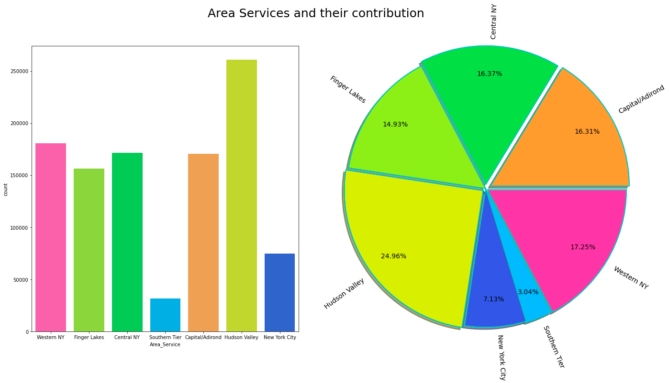
1. Area Service
Team: Data Pirates

Slide 14
Area Service
As the graph Shows:
The highest claims that have came are from the Hudson Valley. Then second is Western New York. The least claims have came from Southern Tier.
Team: Data Pirates

Slide 15
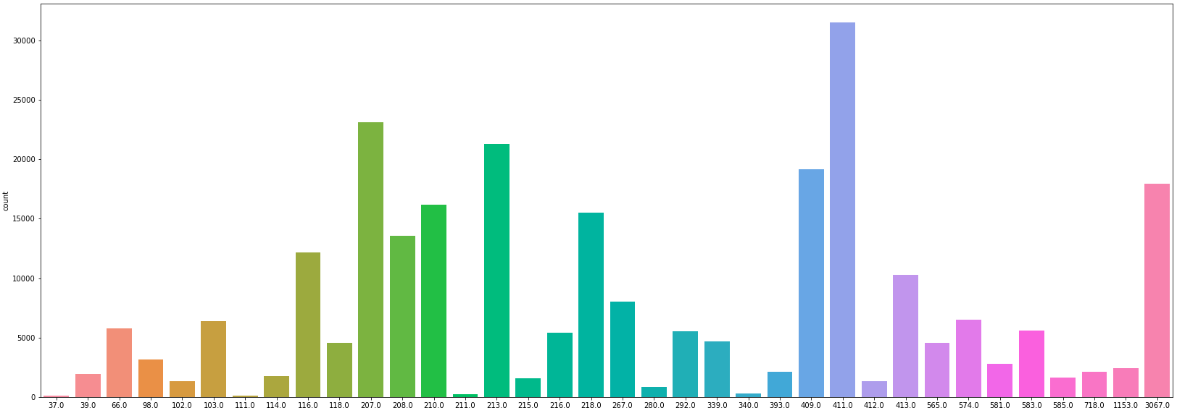
2. Hospital ID (Total 143) Part 1
Team: Data Pirates

Slide 16
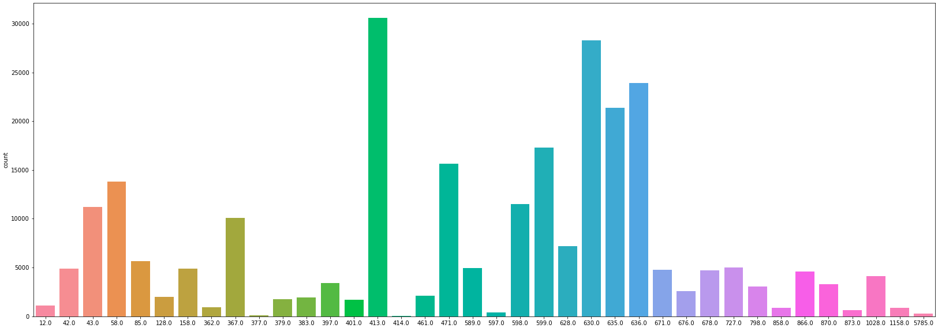
Hospital ID (Total 143) Part 2
Team: Data Pirates

Slide 17
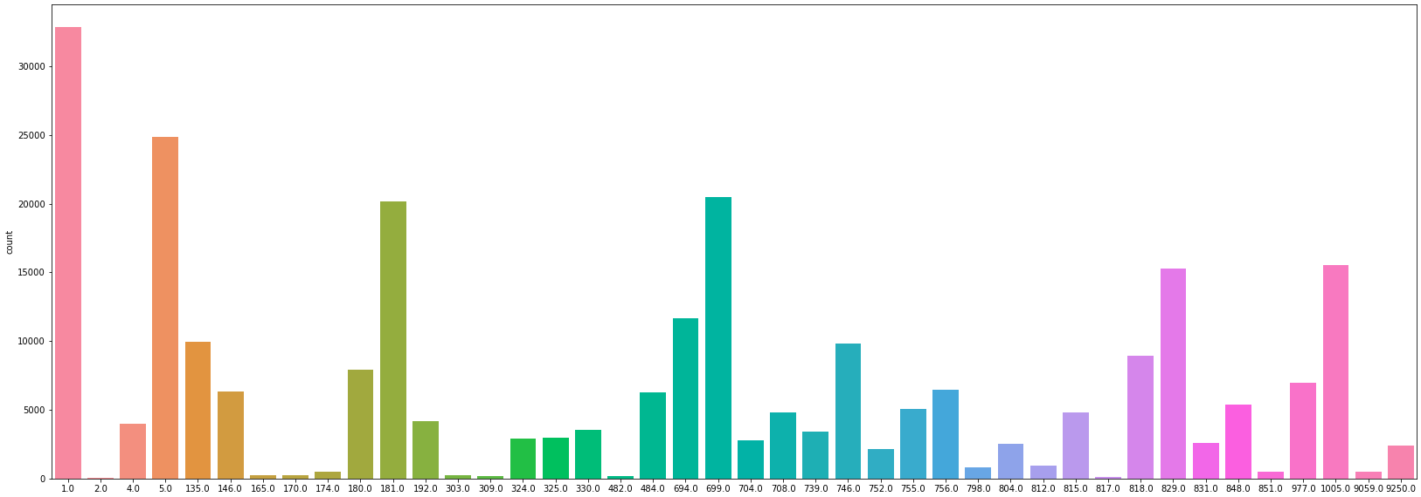
Hospital ID (Total 143) Part 3
Team: Data Pirates

Slide 18
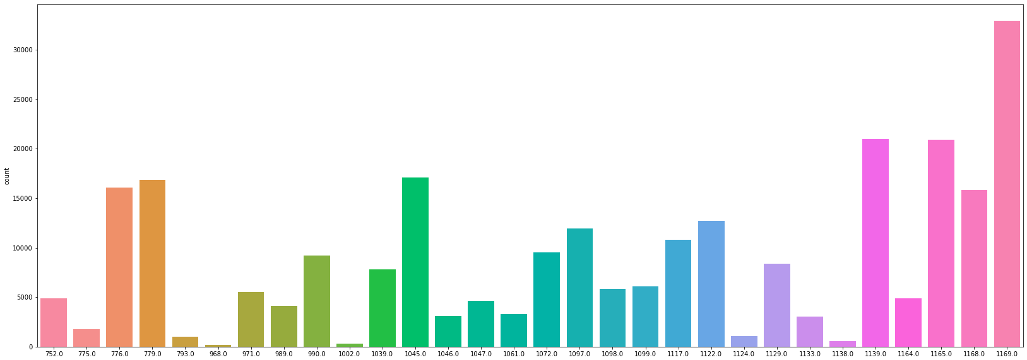
Hospital ID (Total 143) Part 4
Team: Data Pirates

Slide 19
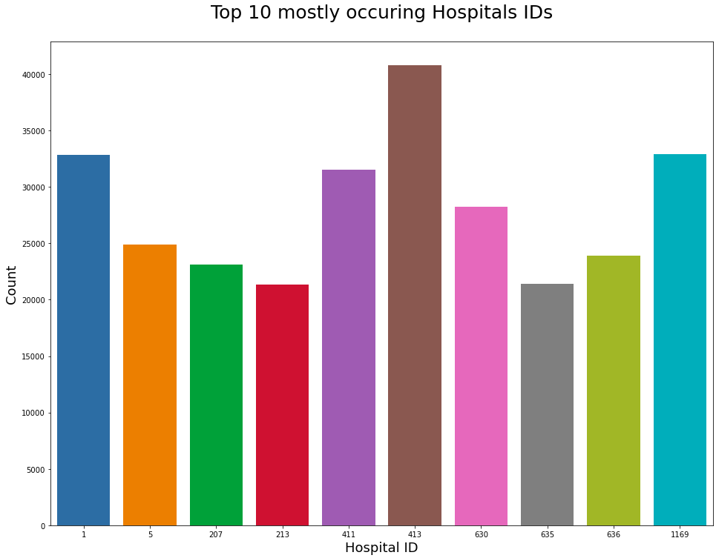
Highest cases have came from the hospital with hospital_id 413, on second number there is hospital_id 1 and so on.
Team: Data Pirates

Slide 20
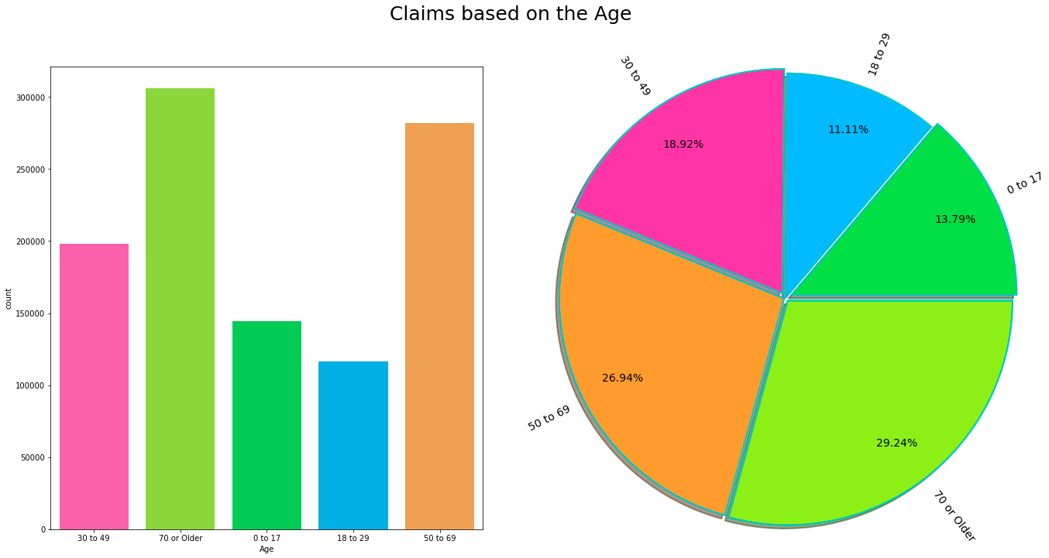
3. AGE(Claims based on age)
Team: Data Pirates

Slide 21
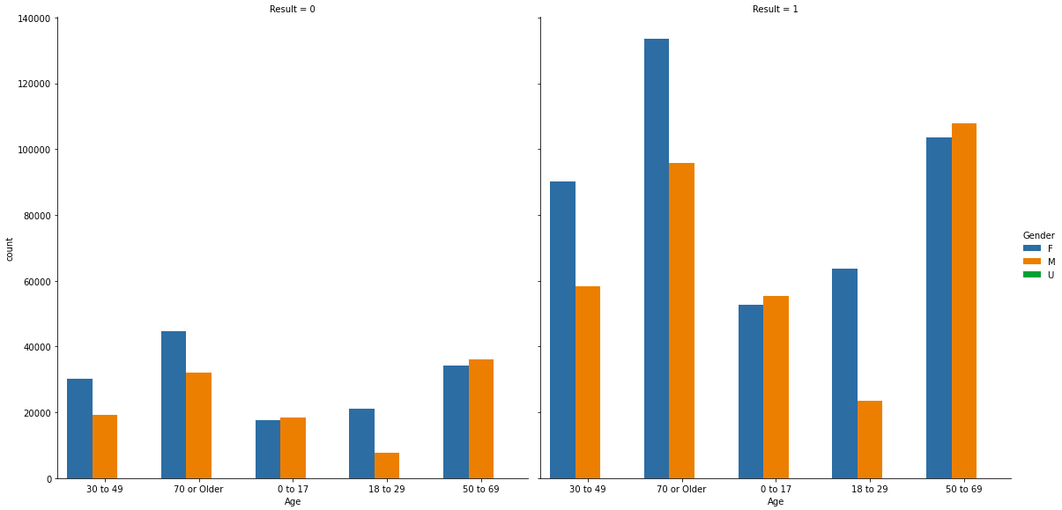
Age and Gender Together
Team: Data Pirates

Slide 22
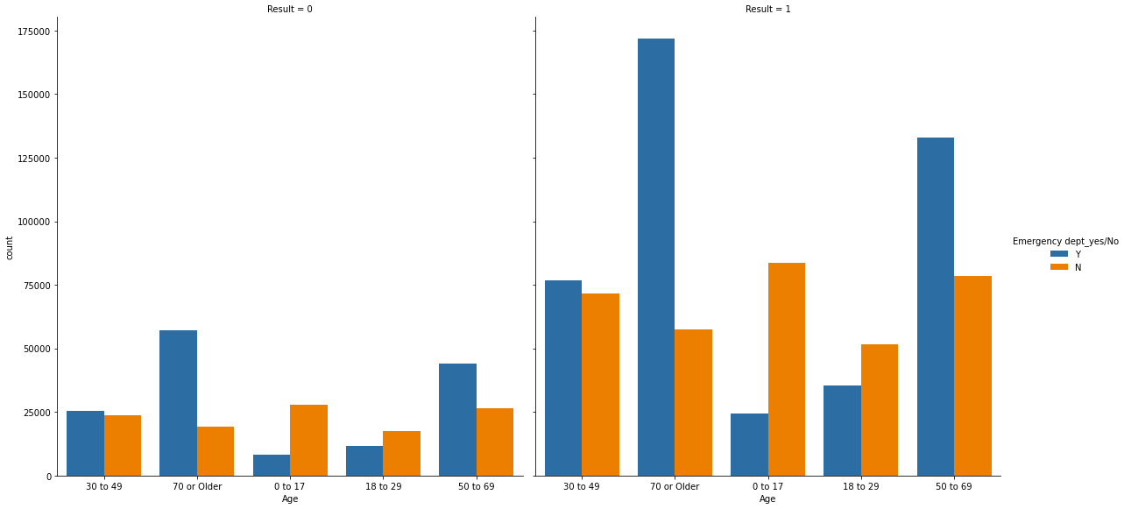
Age and Emergency Case Together
Team: Data Pirates

Slide 23
AGE
As the graph Shows:
The highest claims that have came have age of above 70, and then 50 to 69. From this graph we can easily see the less the age the less claims there will be.
Age vs Gender:
Females are greater in no than males.
Age vs Emergency:
People greater than 70 age are getting into emergency dept.
Team: Data Pirates

Slide 24
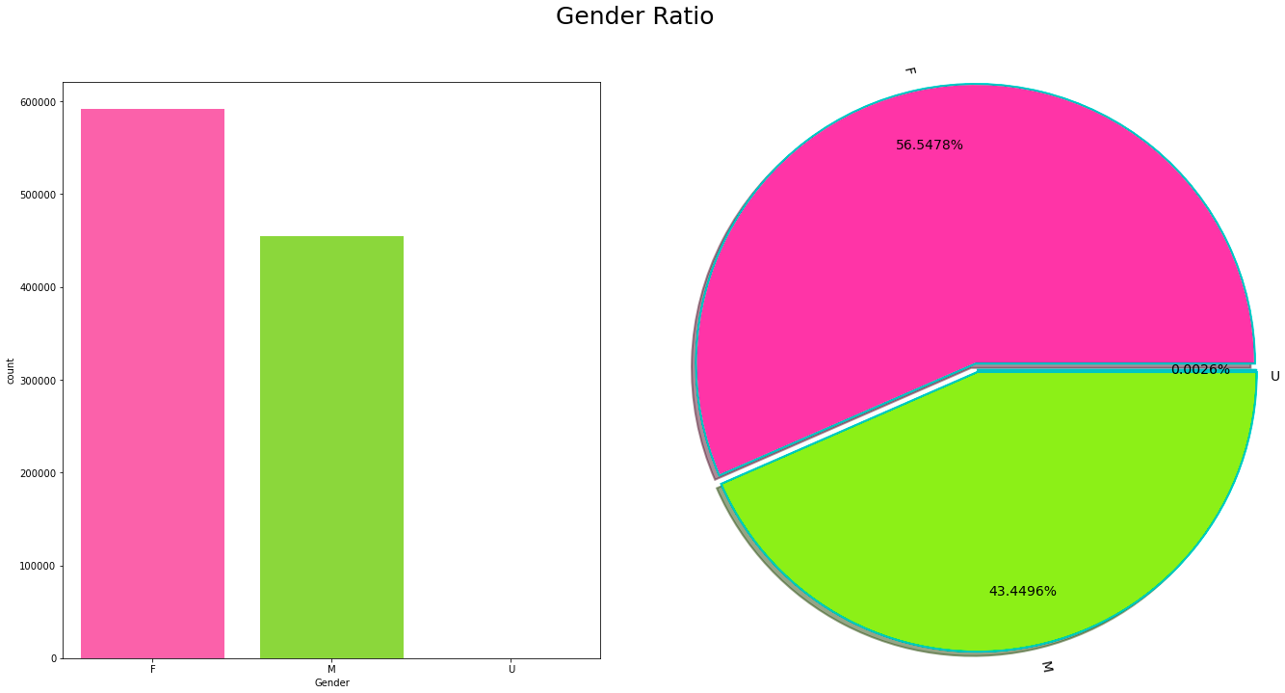
4. Gender(Male/Female/U)
Team: Data Pirates

Slide 25
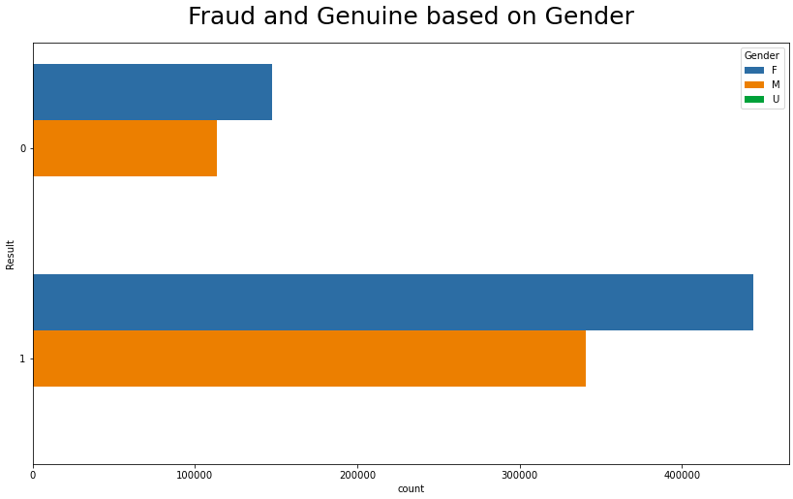
Age and Gender Together
Most of the cases are from females in both genuine and fraud
Team: Data Pirates

Slide 26
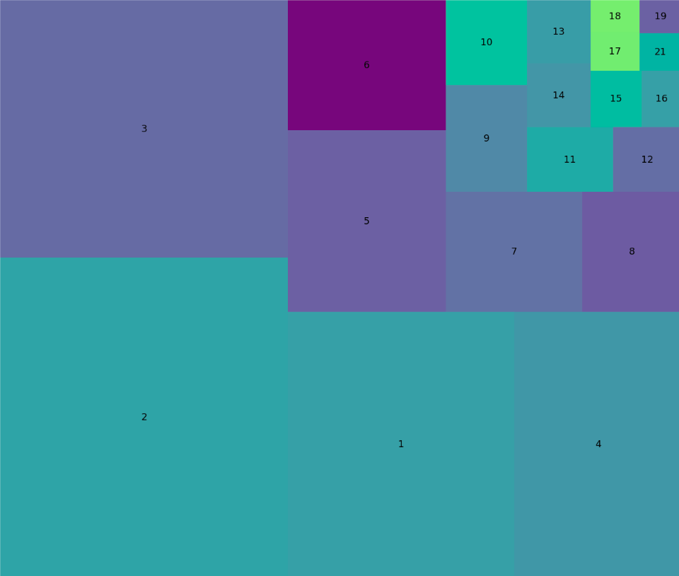
5. Days Spend In Hospital
Most of the Patients have spend only 2 days in the hospital.
Team: Data Pirates

Slide 27
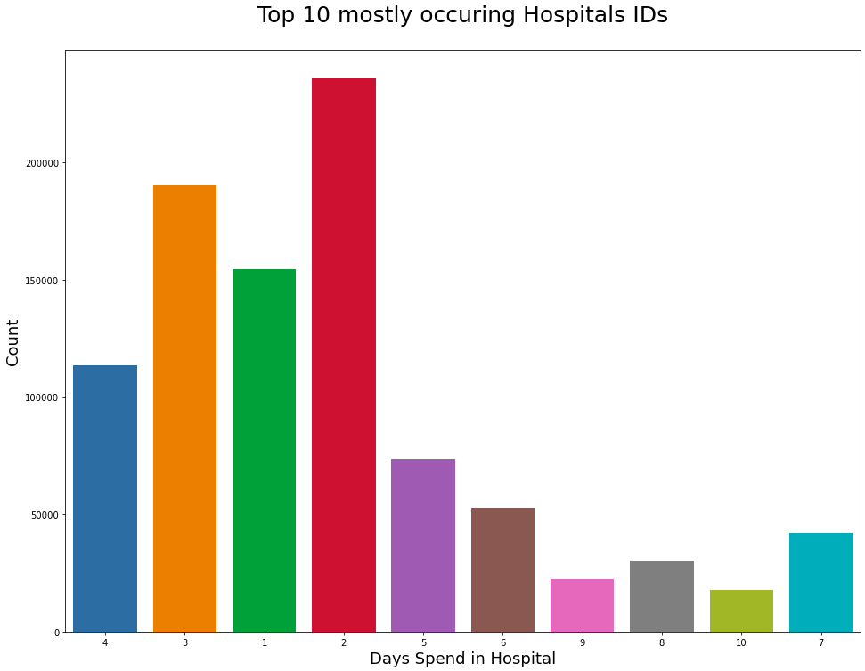
5. Days Spend In Hospital
Most of the Patients have spend only 2 days in the hospital.
Team: Data Pirates

Slide 28
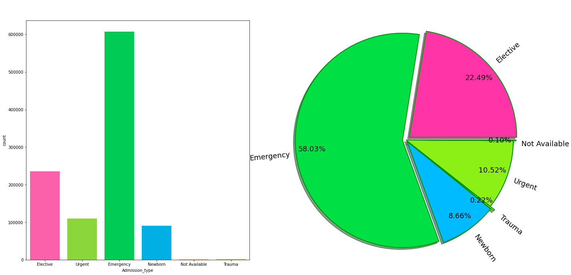
6. Admission Type
Team: Data Pirates

Slide 29
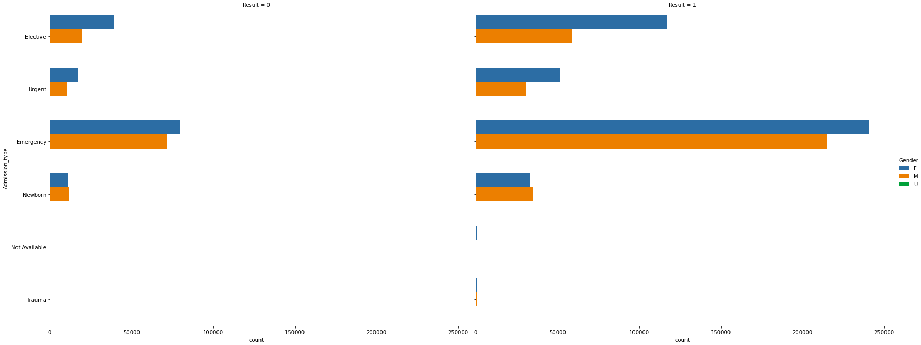
Admission Type and Gender Together
Team: Data Pirates

Slide 30
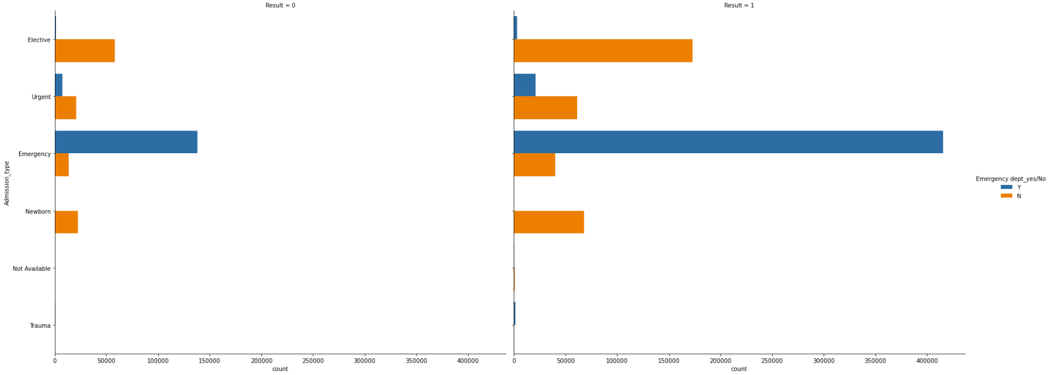
Admission type and Emergency Case Together
Team: Data Pirates

Slide 31
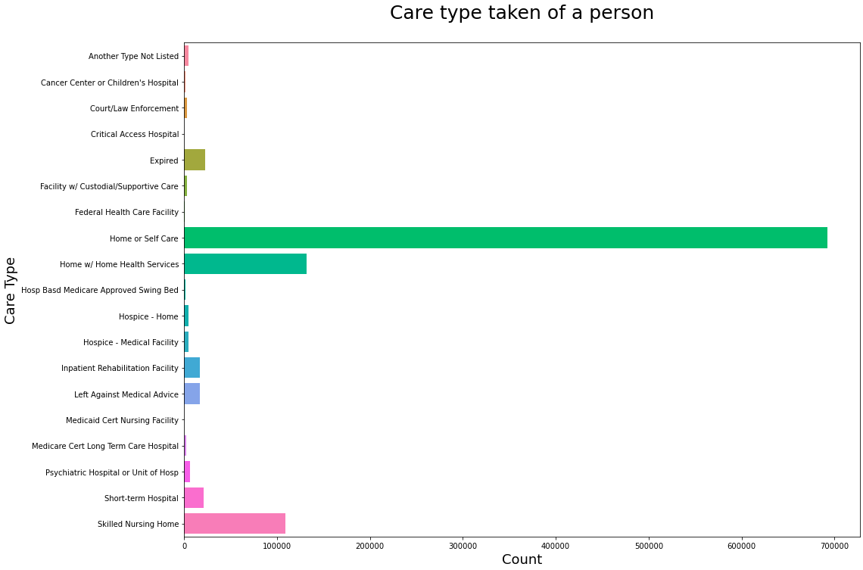
7. Care Type
Almost 6.9 lac patients are from home care category
Team: Data Pirates

Slide 32
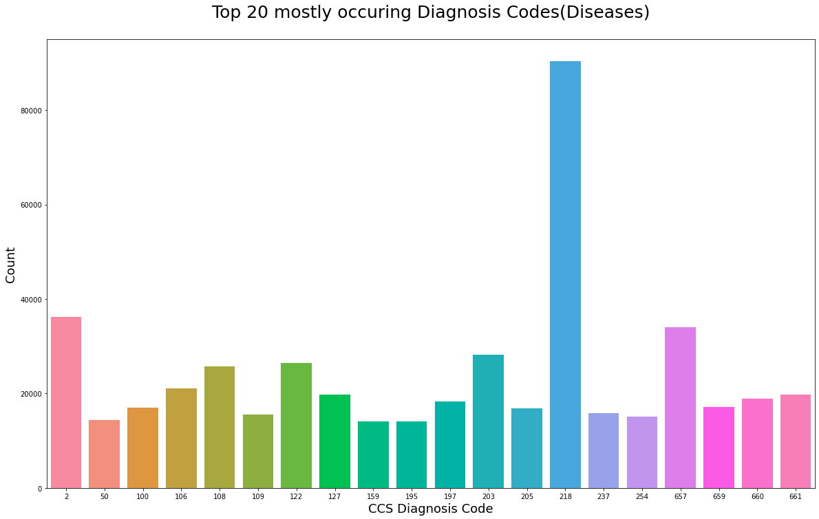
8. CCS Diagnosis Codes(Top 20)
The most number of patients(almost 90k) have been diagnosed under code 218 which is Liveborn(Children Born Alive).
Team: Data Pirates

Slide 33
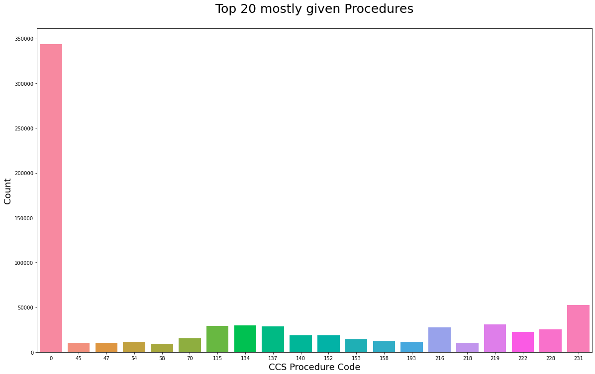
9. CCS Procedure Codes(Top 20)
The most number of patients(almost 340k) have been Procedured under code 0
Team: Data Pirates

Slide 34
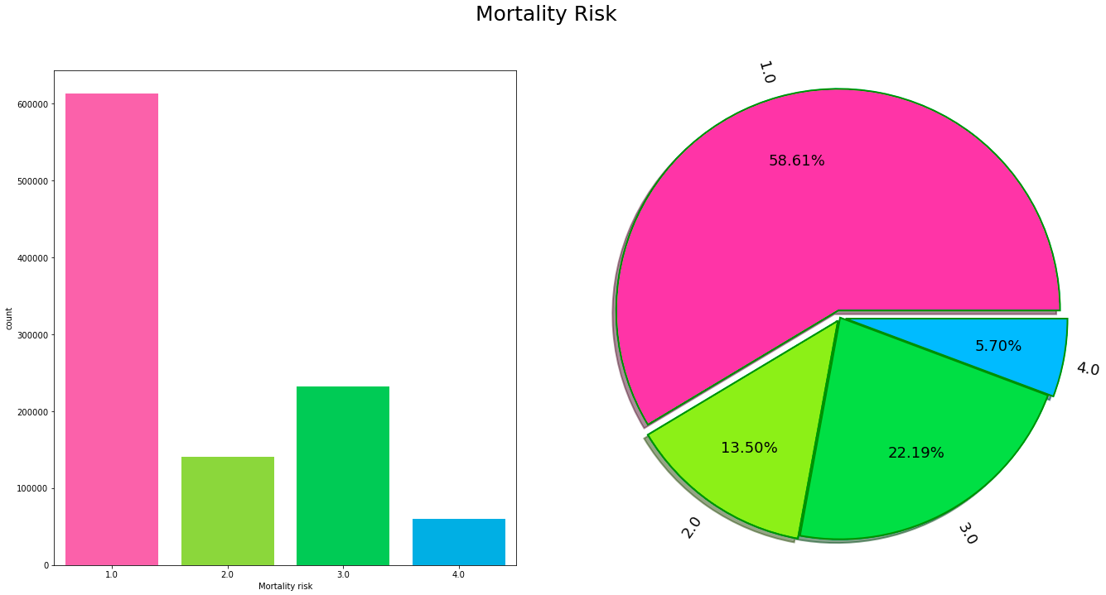
10. Mortality risk
Team: Data Pirates

Slide 35
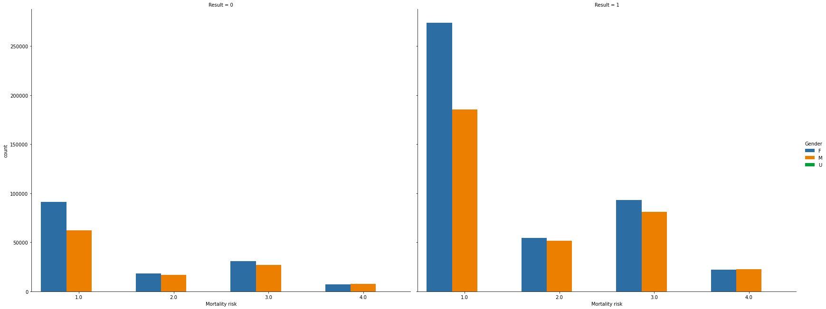
Mortality risk and Gender Together
Team: Data Pirates

Slide 36
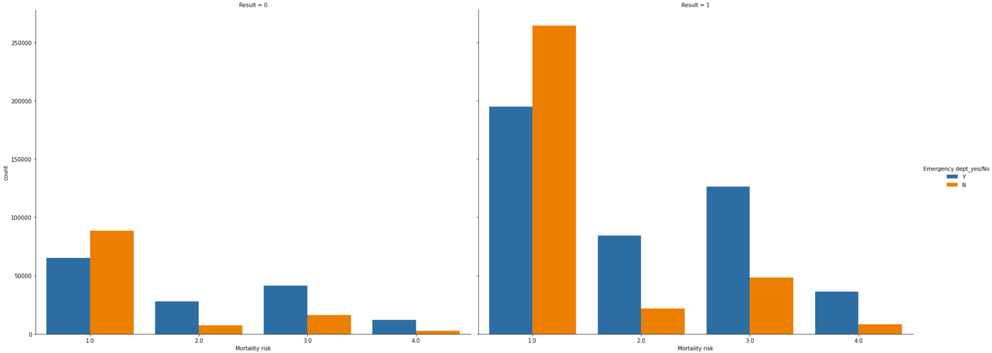
Mortality risk and Emergency Case Together
Team: Data Pirates

Slide 37
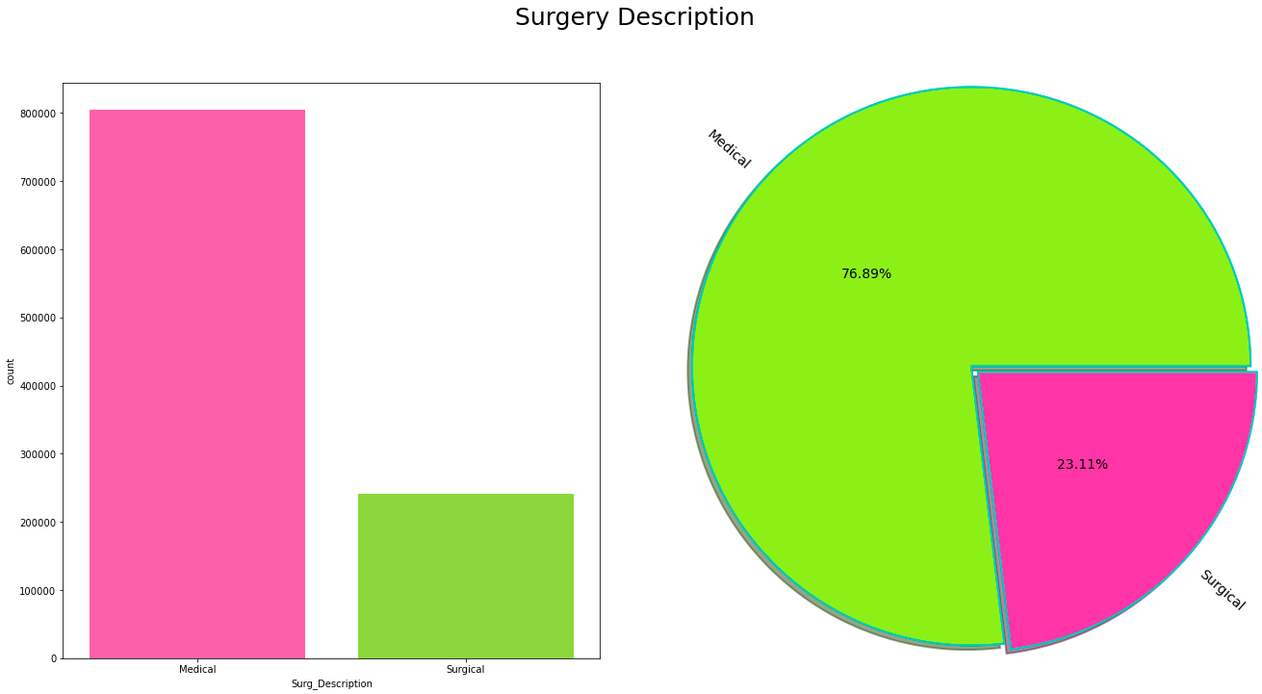
11. Surgery Description
Team: Data Pirates

Slide 38
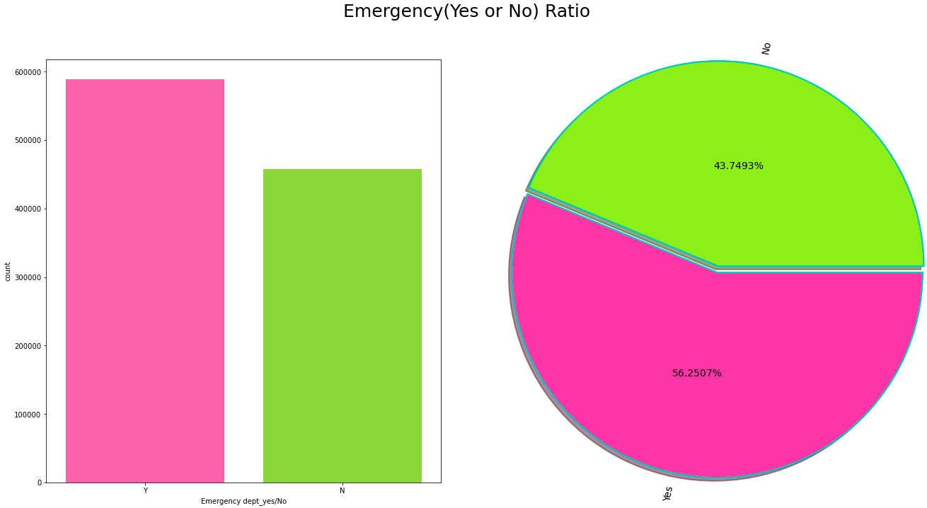
12. Emergency (Yes/No)
Team: Data Pirates

Slide 39
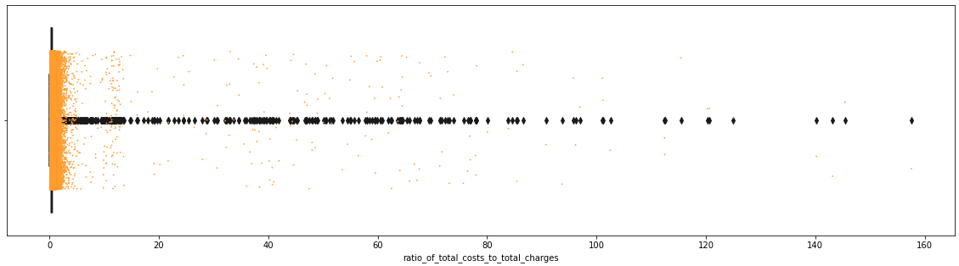
13. Ratio of total cost to total charges
Team: Data Pirates

Slide 40
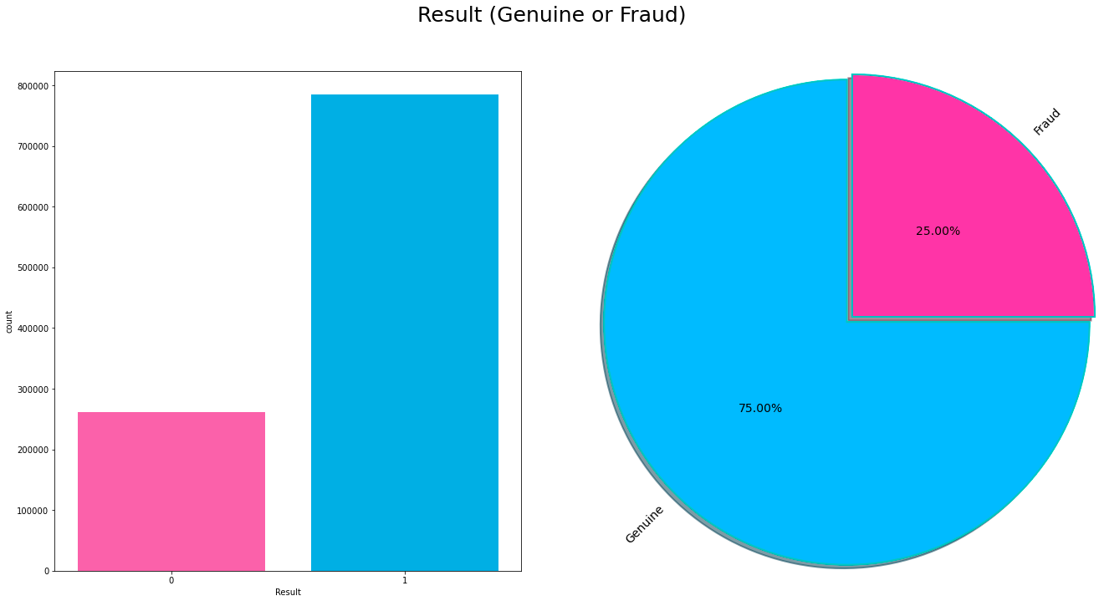
14. Result
Team: Data Pirates

Slide 41

MODEL BUILDING

Slide 42
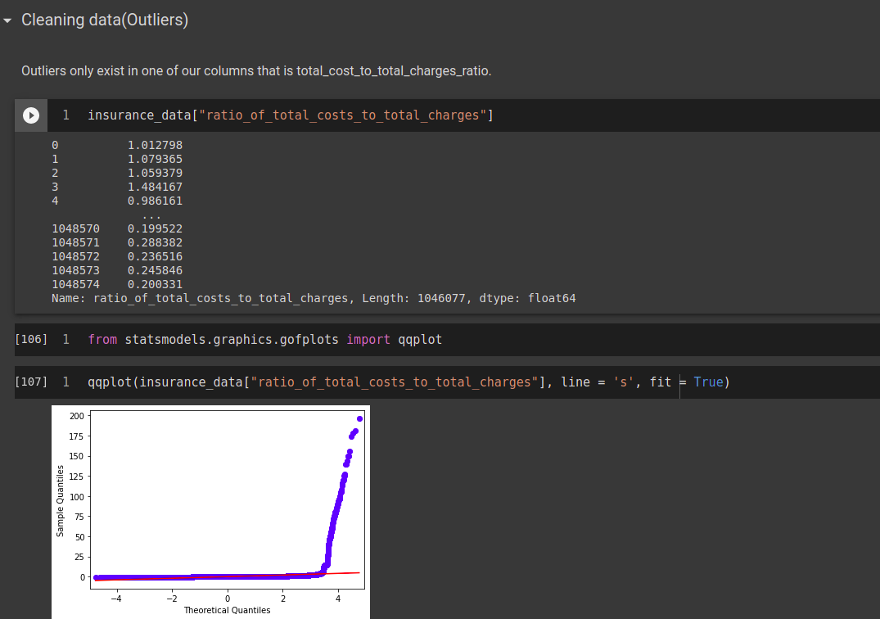
Removing Outliers
Team: Data Pirates

Slide 43
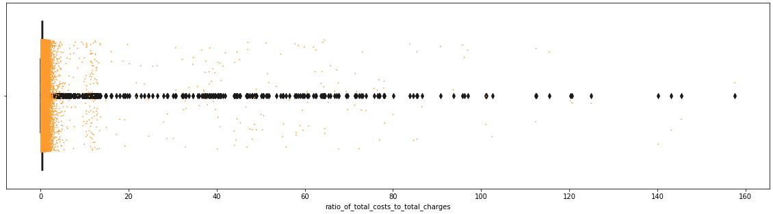
Removing Outliers
Team: Data Pirates

Slide 44
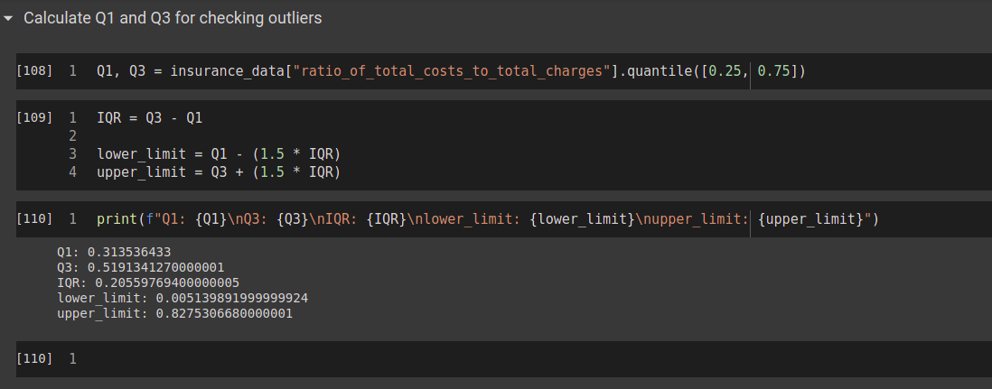
Removing Outliers
Team: Data Pirates

Slide 45
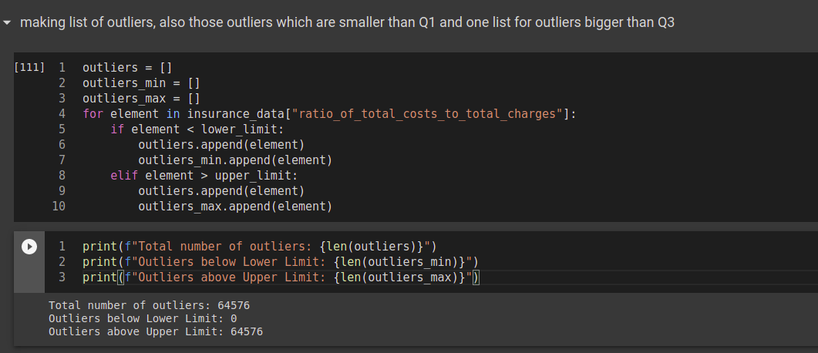
Removing Outliers
Team: Data Pirates

Slide 46
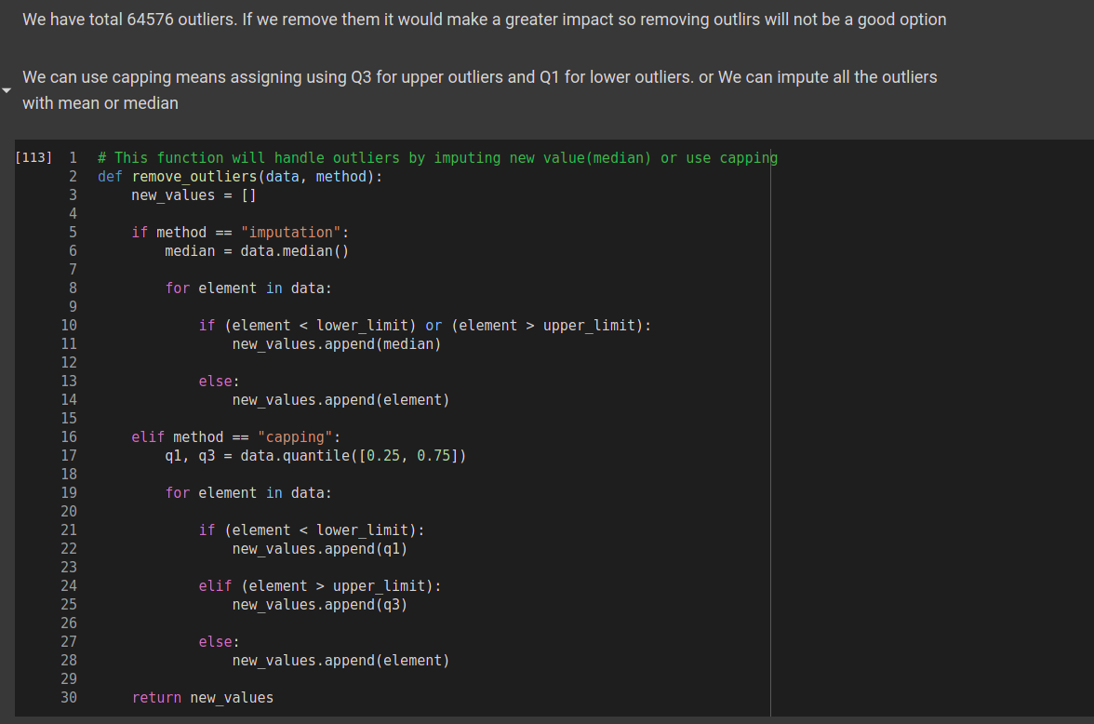
Removing Outliers
Team: Data Pirates

Slide 47
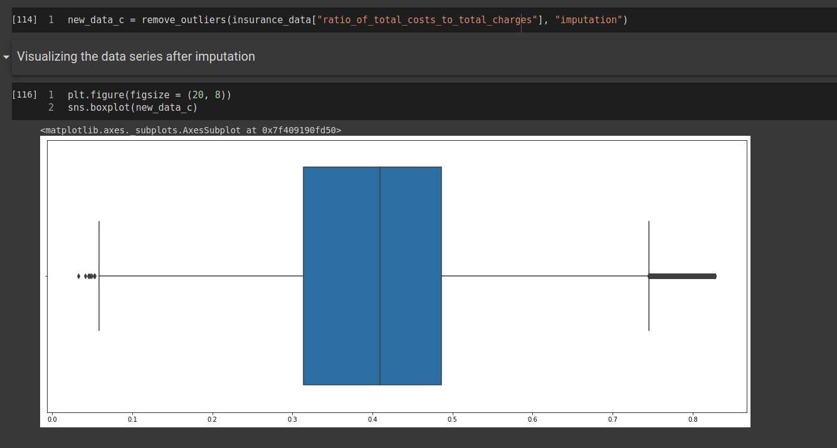
Removing Outliers
Team: Data Pirates

Slide 48
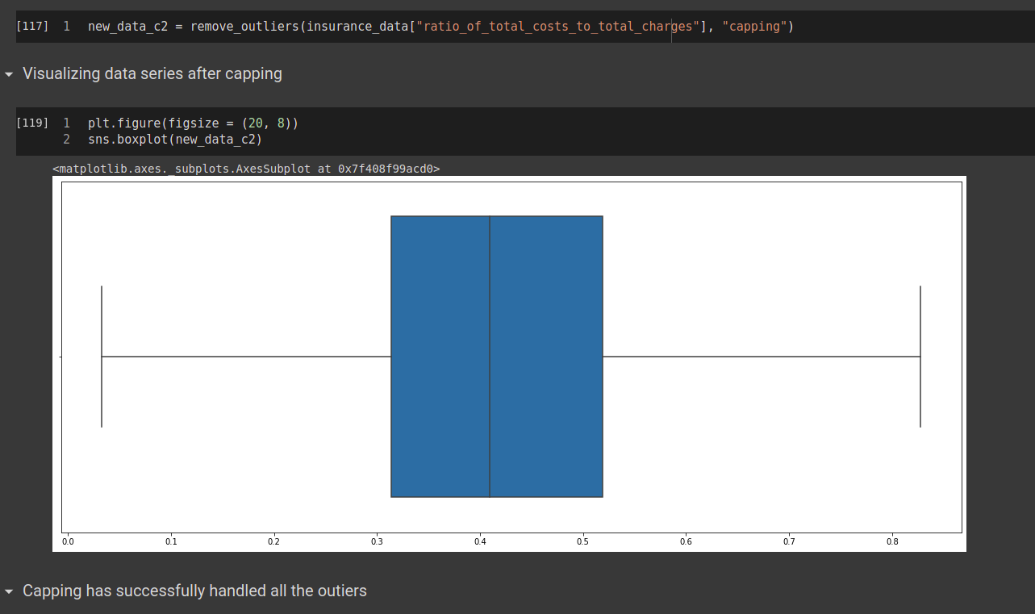
Removing Outliers
Team: Data Pirates

Slide 49
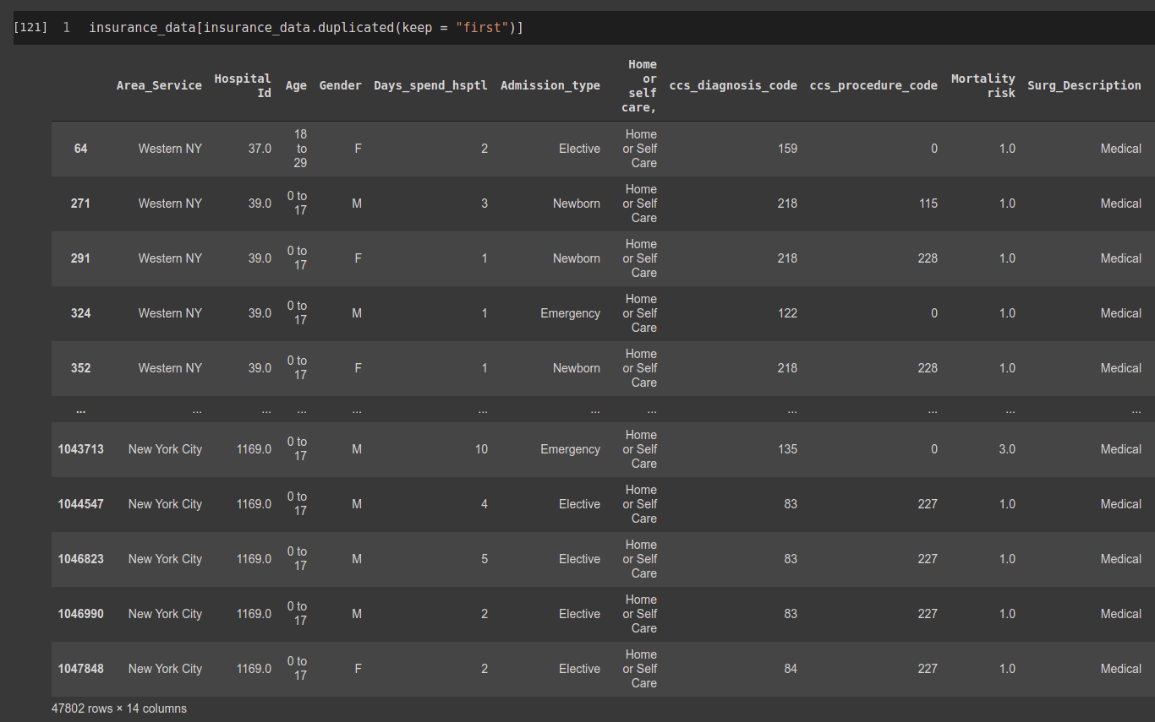
Duplicates
47802 Dupliate records
Team: Data Pirates

Slide 50
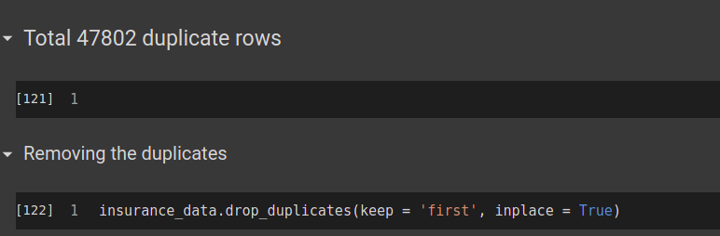
Removing Duplicates
Team: Data Pirates

Slide 51
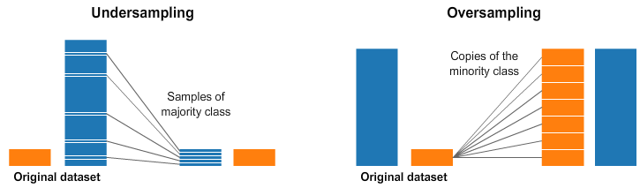
Handling the imbalanced data
Re-sampling
A widely adopted technique for dealing with highly unbalanced datasets is called resampling. It consists of removing samples from the majority class (under-sampling) and/or adding more examples from the minority class (over-sampling).
Team: Data Pirates

Slide 52
Model Details
Team: Data Pirates

Slide 53
Under Sampling (Feature Engg. 1)
S.No | Algorithm Name | Parameters | Train Acc. | Test Acc.
1 | Logistic Regression | (Penalty = ’l2’, solver = ‘newton-cg’, random_state = 50) | 52.55% | 50.28%
2 | Random Forest Classifier | (n_estimators = 100, criterion = ‘gini’, n_jobs = -1, random_state = 50) | 60.49% | 49.5%
3 | Random Forest Classifier | (n_estimators = 350, criterion = ‘gini’, n_jobs = -1, max_leaf_nodes = 15, random_state = 50) | 70.89% | 50.54%
4 | Gradient Boost Classifier | n_estimators = 2000, learning_rate = .5 | 58.3% | 50.22%
5
Team: Data Pirates

Slide 54
Smote Over Sampling (Feature Engg. 1)
S.No | Algorithm Name | Parameters | Train Acc. | Test Acc.
1 | Logistic Regression | (Penalty = ’l2’, solver = ‘newton-cg’, random_state = 50) | 52.55% | 50.28%
2 | Random Forest Classifier | (n_estimators = 100, criterion = ‘gini’, n_jobs = -1, random_state = 50) | 60.49% | 68.85%
3 | Random Forest Classifier | (n_estimators = 350, criterion = ‘gini’, n_jobs = -1, max_leaf_nodes = 15, random_state = 50) | 70.89% | 50.54%
4 | Gradient Boost Classifier | n_estimators = 2000, learning_rate = .5 | 58.3% | 50.22%
5
Team: Data Pirates

Slide 55
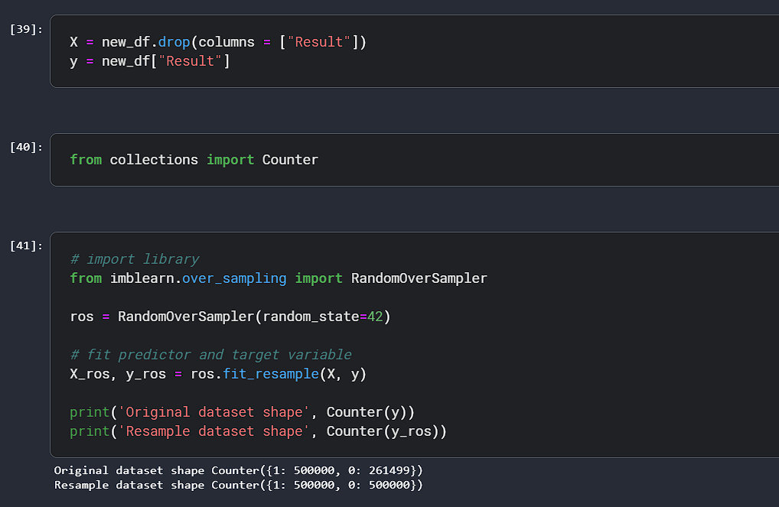
Random Over Sampling
Team: Data Pirates

Slide 56
Random Over Sampling (Feature Engg. 2) Trying with 10lac records
S.No | Algorithm Name | Parameters | Train Acc. | Test Acc.
1 | Random Forest Classifier | (n_estimators = 200, criterion = ‘gini’, n_jobs = -1) | 99.78% | 75.36%
2 | Decision Tree Classifier | Default | 99.78% | 79.77%
Team: Data Pirates

Slide 57
Smote Over Sampling (Feature Engg. 2)
Using All Records
S.No | Algorithm Name | Parameters | Train Acc. | Test Acc.
1 | Random Forest Classifier | (n_estimators = 200, criterion = ‘gini’, n_jobs = -1, random_state = 50) | 99.78% | 86.81%
2 | Random Forest Classifier | (n_estimators = 300, criterion = ‘gini’, n_jobs = -1, max_leaf_nodes = 15, random_state = 50) | 99.7% | 87%
3 | Decision Tree Classifier | Criterion = 'entropy', random_state = 50 | 58.3% | 81.67%
4 | Gradient Boost Alg | loss = 'exponential', criterion = 'mse', n_estimators = 200, learning_rate=0.2, | 51.61% | 50.91%
5 | Decision Tree Classifier | Criterion = 'gini' | 99.77% | 81.79%
Team: Data Pirates

Slide 58
Adding Two More Column: "apr_drg_description", "Hospital County"
S.No | Algorithm Name | Parameters | Train Acc. | Test Acc.
1 | Random Forest Classifier | (n_estimators = 200, criterion = ‘gini’, n_jobs = -1) | 99.77% | 90.3%
2 | Decision Tree Clf | Criterion = ‘gini’ | 99.77% | 81.79%
3 | Random Forest Classifier | (n_estimators = 200, criterion = ‘gini’, n_jobs = -1) train_test_split(90:10) 10% for testing. | 98.6% | 92.9%
4 | MLPClassifier | hidden_layer_sizes = (40,), activation = 'relu', solver = "lbfgs" | 67% | 89%
Team: Data Pirates

Slide 59
params = [{'activation': ['identity', 'logistic', 'tanh', 'relu'],
'solver' : ['lbfgs', 'sgd', 'adam'],
'learning_rate' : ['constant', 'invscaling', 'adaptive']}]
grid_search = GridSearchCV(estimator = clf, param_grid = params, scoring = 'accuracy', cv = 10, n_jobs = -1)
grid_search.fit(X_ros_train, y_ros_train)
Team: Data Pirates

Slide 60
Adding Two More Column: "apr_drg_description", "Hospital County"
S.No | Algorithm Name | Parameters | Train Acc. | Test Acc.
1 | Categorical Naive Bayes | (alpha=1.0, fit_prior=False, class_prior=None, min_categories=10,) | 66.6% | 58.7%
2 | Categorical Naïve Bayes | Default | 65% | 58%
3 | NearestCentroid Classifier | (metric='manhattan') | 50.1% | 50.2%
 | AdaBoostClassifier | (n_estimators=20, random_state=20) | 50.1% | 49.6%
 | Random Forest Classifier | (n_estimators = 120, criterion = 'gini', min_samples_leaf=30, min_samples_split=5, n_jobs = -1) | 92.45% | 89.88%
Team: Data Pirates

Slide 61
parameters = {'criterion': ['gini','entropy'],
'max_depth': range(1, 15),
'max_features': ['sqrt' , 'auto', 'log2'],
}
grid_search = GridSearchCV(decision_tree, param_grid = parameters, cv = 10, verbose = 1, n_jobs = -1)
grid_search.fit(X_ros_train, y_ros_train)
grid.best_params_ : {'criterion': 'gini', 'max_depth': 14, 'max_features': 'sqrt’}
grid.best_score_: 0.5124
Team: Data Pirates

Slide 62
Model Deployment
Team: Data Pirates

Slide 63
Deployment:
The project is finally been deployed using Django (A python web development framework)
Pickled the model using Joblib, Pickle, Json Format, streaming-pickle, cPickle.
Web Deployment:
HTML5
CSS3
Bootstrap4
JavaScript, AJAX
Django

